Slide 1
Direct Effect & Priority Impact Technical Assistant Webinar September 6, 2023
Applying for a Reeve Foundation Quality of Life Grant:
Notes:
Good afternoon! Thank you all for joining us. I am Maria Fonseca, Grants Associate at the Christopher & Dana Reeve Foundation and I would like to welcome you to this Quality of Life Applicant Technical Assistance Webinar. If you need to turn on the closed captioning, there’s an icon on the lower right.. If you any questions please submit them in the Q& A instead of the Chat and the QOL Team will answer them as we go along. We will gather these questions and answers and post them on our websites This presentation and the slides will be available on our website in a few days. . I am going to turn off my camera and share the slides with you

Slide 2
Webinar Overview
Introduction to the Reeve Foundation National Paralysis Resource Center and Quality of Life Grants Program (QOL)
Application Process
Direct Effect Grants Application
Priority Impact Grants Application
Review Process/Grant Selection
Award Notification
Notes:
These are the topics that we will be discussing today.

Slide 3
National Paralysis Resource Center
In partnership with the Administration for Community Living, the National Paralysis Resource Center (NPRC) provides much-needed free educational information, programs, emotional support, and individualized assistance to Americans living with paralysis, along with their caregivers, families, and medical professionals.
Once you
choose hope,
anything’s
possible.”
— CHRISTOPHER REEVE
00/ 00/ 00
*Cooperative Agreement Grant Number: 90PRRC0003
Notes:
This grant program is part of the The Christopher & Dana Reeve Foundation’s National Paralysis Resource Center has been federally funded since 2014 through a cooperative agreement with the U.S. Department of Health and Human Services Administration for Community Living (ACL).
The National PRC provides deeply-needed information, programs and individualized support and assistance to the over 5.3 million Americans living with paralysis.

Slide 4
Introduction to the Reeve Foundation
The Christopher & Dana Reeve Foundation is paralysis-focused, and as such, our grant funding must be targeted to projects that will serve individuals living with paralysis, their families, and caregivers.
The Reeve Foundation uses a functional definition of paralysis: difficulty and/or inability to use arms and/or legs due to neurological conditions including (but not limited to) spinal cord injury, traumatic brain injury, stroke, cerebral palsy, spina bifida, ALS, post-polio syndrome, etc.
Notes:
What’s important to know is that we are paralysis-focused and that grant funding must be targeted to projects that will serve individuals living with paralysis, their families, and caregivers.
We also use a functional definition of paralysis: difficulty and/or inability to use arms and/or legs due to neurological conditions including (but not limited to) spinal cord injury, traumatic brain injury, stroke, cerebral palsy, spina bifida, ALS, post-polio syndrome, and others.
While we will consider supporting programs that include people that have co-occurring disabilities, as well as inclusive community projects, proposed projects must serve a majority of people with paralysis.
and at least 3 individuals with paralysis and/or their families and caregivers.

Slide 5
National Paralysis Resource Center
In 2002, the National Paralysis Resource Center opened its doors to promote the health, independence, and well-being of individuals living with paralysis by providing comprehensive resources, education, and referral services.
Information Specialists Provide individualized support and guidance to people living with paralysis, as well as their families and caregivers.
Peer & Family Support Program Offers peer-to-peer support to help families impacted by paralysis navigate the short-term realities and long-term challenges.
Quality Of Life Grants Program Awards financial support to nonprofit organizations that mirror the Reeve Foundation’s mission to improve quality of life.
Military & Veterans Program Supports the unique needs of service men and women regardless of when they served or how they were injured.
PAGE 5

Slide 6
Today’s Care. Tomorrow’s Cure.®
Information Specialists
124,000+ families have received one-on-one assistance in 170 languages
Quality of Life Grants
41 million awarded to over 3,700 non-profit programs in all 50 states
Reeve Summit:
Where Care, Cure and Community Connect
Annual summit with a spectrum of care and cure topics designed for the community and professionals
Paralysis Resource Guide 225,000+ copies distributed to the Reeve Foundation’s community
1st call made when loved one is diagnosed with paralysis
Virtual Community
3M+ users visit ChristopherReeve.org and social media channels annually
Global Leader in Spinal Cord Research
$140 million has been awarded to researchers around the globe to speed the development of treatments and therapies for spinal cord injury
Team Reeve®
$7 million has been raised from running marathons to hosting local events
Peer & Family Support Program
20,000+ people have received support from 500+ certified peer mentors who are also living with paralysis
PAGE 6
Notes:
Our Mission
We are dedicated to curing spinal cord injury by advancing innovative research and improving the quality of life for individuals and families impacted by paralysis, for our mission of today’s cae
In addition to our QOL Program, We offer an array of free services and resources to the paralysis community. We have a team of information specialists that is available to provide individual support, printed and digital resources, peer & family support groups, and a yearly summit that will take place next year in March 2023 in DC.

Slide 7
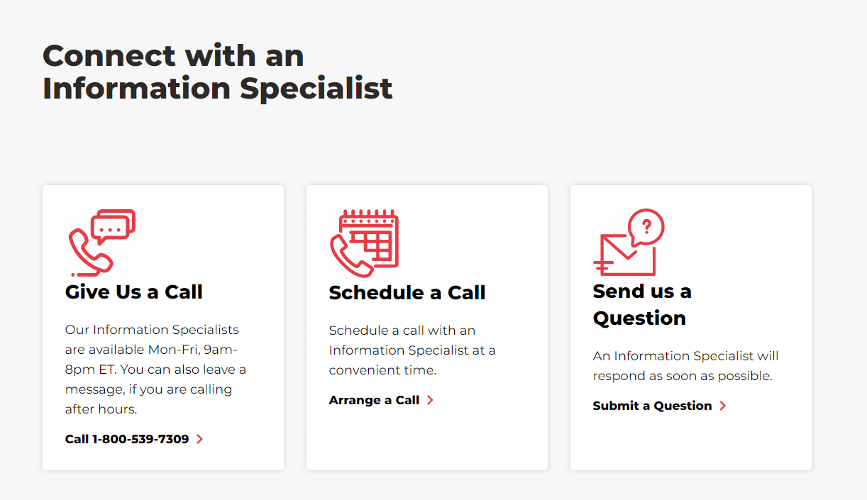
Notes:
The Reeve Foundation cannot award grants to individuals, but our team of Information Specialists can help you identify resources that provide financial assistance. You can call us toll-free at 1-800-539-7309 or send us a question through our simple online form.

Slide 8
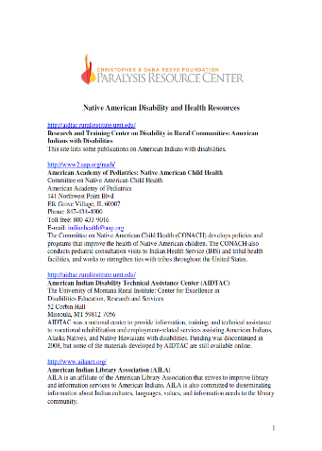
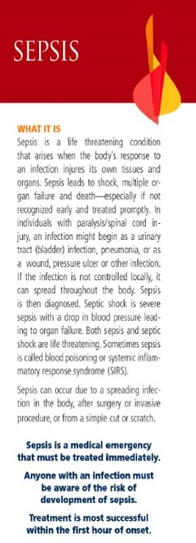
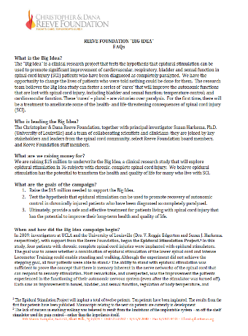
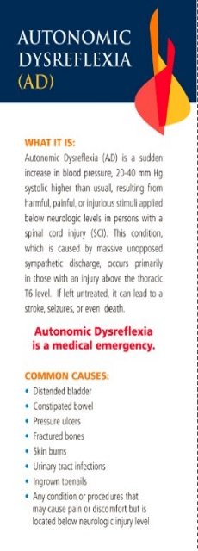
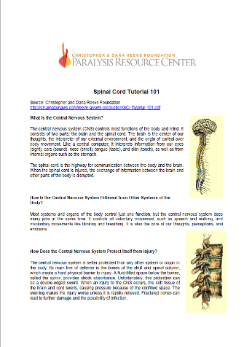
Free Materials & Resources
Notes:
All of our resources are free – including our flagship publication, the Paralysis Resource Guide, available in English and Spanish and 10 other languages .We have wallet cards on Autonomic dysreflexia, other secondary conditions. There are publications on bladder and bowel management, pressure injuries, and advocating for the rights of children living with paralysis and employment. State fact sheets and many other resources are also available.
These materials are available for your own organizations as well as for those you serve. You can order them directly on our website or
Contact an information specialist and they can be sent to you, at no charge.

Slide 9
Quality of Life Grants Program
The Christopher & Dana Reeve Foundation Quality of Life Grants Program, created by the late Dana Reeve has awarded since its inception in 1999 a total of over $41 million to more than 3,700 projects across the United States Grants have funded nonprofits, tribal entities, and municipalities for a wide array of projects, programs, and services.
Notes:
The QOL program that you are all interested in applying is part of the NPRC . Dana Reeve passionately believed that while working towards a cure, there are millions of people who deserve an improved quality of life and it was her vision that started this program which has awarded since 1999 over $41 million dollars to more that 3,700 projects.

Slide 10
Important Dates
2nd Cycle 2023 Program Timeline
Direct Effect (Tier 1) and Priority Impact (Tiers 2-4)
Cycle Opens: August 30, 2023
Deadline for emailed questions: September 12, 2023 (email to QoL@ChristopherReeve.org)
Proposals Due: October 11, 2023
External Review: October 16 – November 3
Internal Review: November 8 – December 5
Grants awarded by the end of December
Grant period begins January 1, 2024
Notes:
Deadlines to keep in mind .

Slide 11
Quality of Life Grants: Direct Effect & Priority Impact
QOL grant applications are available and are to be completed online through the Reeve Foundation online grants portal.
The online application submission deadline is Wednesday, October 11, at 11:59 pm EASTERN TIME.
Notes:
For this cycle we will be offering Direct Effect and Priority Impact Grants - and submissions are due October 11th – You can only submit one application, per cycle, - also from one of the questions submitted with the registration
If an organization has already applied once in 2023 but were declined, can they apply again?

Slide 12
Application Tools
Grant Application and Program Guidelines
People First Language Guide
Quick Guide to Establishing Evaluation Indicators
Videos and Tutorials
All are available on our website at: ChristopherReeve.org/qol or scan the QR Code.
Notes:
To further assist you in completing your application, all these tools are available on our website

Slide 13
Tiered Grants Structure for this Cycle
FOR THIS CYCLE - YOU CAN APPLY FOR:
Direct Effect
Project to be completed in 12 months
Grants up to $25,000
Interim Report at 6 months
Final Report at 12 months
NOTE: All requests for $25,000 must include a valid SAM.gov issued Unique Entity Id number (UEI#)
Notes:
Direct Effect Quality of Life grants fund specific budget items up to a total of $25,000 to support the wide range of projects and activities that will clearly impact individuals living with paralysis and their families. If you are funded and accept this grant, the terms require you to complete an interim report at 6 months and a final at 12 months.
These grants are for projects that will begin in January 1, 2024 –There are instructions in the application on how to apply for a sam.gov number

Slide 14
Direct Effect Project Types
Accessible Beach/Dock/Pier
Accessible Community Spaces
Accessible Playground/Ballfield
Accessible Trail
Adaptive Sports
Advocacy
Arts
Camp
Caregiving
Consumer Education
Durable Medical Equipment
Education
Employment
Facility Accessibility Modifications
Fitness and Wellness
Healthcare
Media Development
Peer Mentoring and Support
Service Animal Program
Therapeutic Horseback Riding
Transitioning Home
Notes:
Direct Effect Quality of Life grants fund the same wide range of projects as those funded in the prior Quality of Life grants program, including: READ ABOVE,
Examples of types of Projects funded include:
sports wheelchairs for a wheelchair basketball team, adapted glider in a community playground, kayak for a rowing program, accessible gym equipment, hydraulic lift at a pool, electronic door openers at a community center, wheelchair accessible picnic table at a county fairground, camp programs, subsidized lessons for therapeutic riding, transportation costs for an inclusive afterschool program, support groups

Slide 15
Types of Direct Effect (Tier 1) Projects Funded Examples
Sports wheelchairs for a wheelchair basketball team
Adapted glider in a community playground
Kayak for a rowing program
Accessible gym equipment
Hydraulic lift at a pool
Electronic door openers at a community center
Workshop education series on sex and sexuality with a spinal cord injury
Wheelchair-accessible picnic table at a county fairground
Program for preventing abuse in adaptive sports
Camp programs
Subsidized lessons for therapeutic riding
Transportation costs for an inclusive after-school program
Support groups
Notes:
Examples of Direct Effect Projects funded include: READ
, visit our website and search for past grantees

Slide 16
Tiered Grants Structure for this Cycle
FOR THIS CYCLE - YOU CAN APPLY FOR:
Priority Impact
Project to be completed as noted in the following slides
Grants range from $30,000 to $50,000
Interim Report noted in the following slides
Final Report noted in the following slides
NOTE: All requests for $25,000 and above must include a valid SAM.gov issued Unique Entity Id number (UEI#)
Notes:
Direct Effect Quality of Life grants fund specific budget items up to a total of $25,000 to support the wide range of projects and activities that will clearly impact individuals living with paralysis and their families. If you are funded and accept this grant, the terms require you to complete an interim report at 6 months and a final at 12 months.
These grants are for projects that will begin in January 1, 2024 –There are instructions in the application on how to apply for a sam.gov number

Slide 17
Tiered Grants Structure for this Cycle
PRIORITY IMPACT – Tier 2
Grants up to $30,000 and must be completed within 12 months
Assistive Technology - This tier is open to all organizations with the continued emphasis on increasing the independence of people living with paralysis, to assist them to participate fully in the communities of which they are a part and enhance their social, employment, education, or finance-related quality of life using assistive technology.
Disaster Preparedness – Grant funds support nonprofit organizations and programs that address the needs of emergency preparedness and the needs of people with paralysis in a natural disaster environment.
Respite/Caregiving – This grant area recognizes family caregivers and the vital role they play in caring for those with paralysis. Funds support nonprofits that offer exemplary and innovative respite care services that are evidence-based, appear promising, or are trying new service models.
Notes:
Priority Impact grants fund priority issues for individuals living with paralysis.
New booklet on disaster preparedness if interested

Slide 18
Tiered Grants Structure for this Cycle
PRIORITY IMPACT – Tier 3
Grants up to $40,000 and must be completed within 18 months
Racial Equity – The Reeve Foundation’s new Racial Equity grants program aims to fund projects that explicitly benefit people and communities that are racially diverse and/or historically underserved living with paralysis and/or promote racial equity for people living with paralysis. The projects may focus on several issues that enhance the quality of life of those individuals living at the crossroads of racial inequity and paralysis, especially those from Black, Latino, Indigenous and Native American, Asian American, and Pacific Islander communities, and other marginalized racial groups.
We urge you to examine the needs of your communities. These projects should identify how your organization aims to address the injustices and inequalities affecting targeted population(s) within your community that are racially diverse and/or historically underserved.
Notes:
Our organization provides aluminum removable ramps to provide home accessibility to underserved and rural people with spinal cord injuries. Are we eligible for a grant?

Slide 19
Tiered Grants Structure for this Cycle
PRIORITY IMPACT – Tier 3
Grants up to $40,000 and must be completed within 18 months
Rural Unserved and Underserved - The aim of the Reeve Foundation’s grant program is to fund projects that explicitly benefit people living with paralysis in unserved and underserved rural communities.
Projects will focus on promoting accessibility and participation in rural communities, for example, by providing access to safe transportation, broadband internet, care coordination, agriculture, and access to healthy food.
Notes:
Our organization provides aluminum removable ramps to provide home accessibility to underserved and rural people with spinal cord injuries. Are we eligible for a grant?

Slide 20
Tiered Grants Structure for this Cycle
PRIORITY IMPACT – Tier 3
Notes:
I want to mention that If you are selecting rural unserved and underserved as your project type, it will branch out to this question to ask details about the population you are trying to serve.

Slide 21
Tiered Grants Structure for this Cycle
PRIORITY IMPACT – Tier 4
Grants up to $50,000 and must be completed within 24 months
Employment – Priority Impact grants are one of Reeve’s top priorities because employment is fundamental in achieving and maintaining independence while being one of the most challenging obstacles to individuals living with paralysis. In addition, gainful employment allows people living with paralysis to achieve enhanced financial security, higher quality of life, and improved community connections.
Grants funds may not provide stipends and funds may not be given directly to workers or program participants as salaries or other incentives.
Nursing Home Transition – Funds support Centers for Independent Living (CILs) and other organizations that provide transition services across the country to transition people with paralysis living in nursing homes back into their homes or a community-based setting of their choice. Funds also support projects focused on diversion (keeping people living with paralysis who are at risk from entering a nursing home).
Notes:
Nursing home transition – where the grant amount has been changed from previous cycles, We actually conducted a Learning Community meeting with past nursing home transition grantees,
And from their feedback, re-evaluate the need to increase the amount for this tier. Please note that for Nursing Home Transition applications ONLY:
Award funds can be used to address barriers to facilitating successful nursing home transitions for individuals with paralysis. This may include Start-Up Costs (e.g., housing deposits), Equipment (e.g., medical devices, AT, Hoyer lifts, adaptive equipment), Supplies (e.g., start-up supplies, general home furnishings, including stoves, washers/dryers, etc.), Transportation/Travel, and Other Costs not outlined in the application (e.g., Indirect costs, fees for filing legal documents, independent living skills training, and other line items that address barriers which have not been noted in the application materials). Funds can also be allocated to expand personnel capacity so that staff time could be used to transition individuals (e.g., a part-time role can be converted into a full-time position to complete more assessments, in-person visits, etc.).
However, these expenses are not allowable for the Direct Effect “Transitioning Home” focus area.

Slide 22
New Eligibility Requirement
New Building Community Capacity Initiative
Under our new five-year (July 1, 2021-June 30, 2026) cooperative agreement with the Administration for Community Living (ACL), we strive to ensure a level playing field and opportunities for the numerous organizations that apply for QOL grants that serve people living with paralysis. Under this initiative, organizations awarded a grant during the July 1, 2021- June 30, 2026, period will not be eligible for a second or subsequent award in the same category of grants until after June 30, 2026.
Grantees awarded during this period may apply for funding under a different tier or category of grants within the same tier. All awarded applicants can re-apply for funding after one year of the close of your grant and notification of grant closure by the Reeve Foundation.
Notes:
Before we move on to the application - Here is a NEW eligibility requirement that I want to make sure everyone understands. Previously, the waiting period for re-applying for funding after receiving a grant was one year from your grant closure. With this new cooperative agreement, we are striving to create a level playing field and opportunities for the organizations applying for funding. So, we have instituted a waiting period of five years, but that’s only WITHIN THE SAME CATEGORY. Any other category or tier will still be a one year waiting period from your previous grant closure. For example, there are Five (5) Tiers of funding available twice a year. If your organization receives a Tier 1 Adaptive Sports grant this cycle, you must wait one year after the grant is completed and you receive notification from us that you grant has closed before you can apply for any other Quality of Life grant. Your organization will be ineligible for a second Tier 1 Adaptive Sports grant until after June 30, 2026, but you may apply for other categories in the same tier or for other tiers of funding.
If you have any questions regarding our new building community capacity initiative, and when you are able to re-apply please email QOL@ChristopherReeve.org with the Subject Line “Eligibility Question.”

Slide 23
Accessing the Online Grants Portal
Reeve Foundation online grants portal
(https://www.grantinterface.com/Home/Logon?urlkey=christopherreeve)
QOL@ChristopherReeve.org
administrator@grantinterface.com
Notes:
Grant Applications are completed online through a link to the Reeve Foundation online grants portal . You can find the link on our website and in the Grant Application and Program guidelines. Once these slides are posted, you may copy and paste the url that’s shown into your website browser.
We also ask you to please add QOL@ChristopherReeve.org and administrator@grantinterface.com to your acceptable email address list to avoid having email communication from the Reeve Foundation blocked by SPAM blocker software. The administrator@grantinterface.com emails are those that will be coming to you directly from our online grants system.
After clicking on the link to access the Reeve Foundation grant portal, you will be brought to the Logon Page. If this is your first time applying for a grant, you will need to create a new account. Click on the “Create New Account” button and you will be asked to input contact information, please provide a minimum of 2 contacts, and information about your organization (thus, creating an organizational profile). If you need assistance, there is a link to a registration tutorial video on the portal page or email us here at QOL@ChristopherReeve.org.
If you have applied in the past enter your email address and the password that you had previously created. If you’ve forgotten your password, click on the “Forgot your Password?” link and an email will be sent to you with your password. If you do not remember or have access to the email account related to the organization, contact QOL@ChristopherReeve.org for assistance. It’s really important that you enter an email address and password that is already connected with the organization’s account. Please do not create a duplicate organization profile, as all organizational application history is connected to the grant profile.
Please be sure to review your organization and contact profiles in the online system and update them with your most current information.
Z

Slide 24
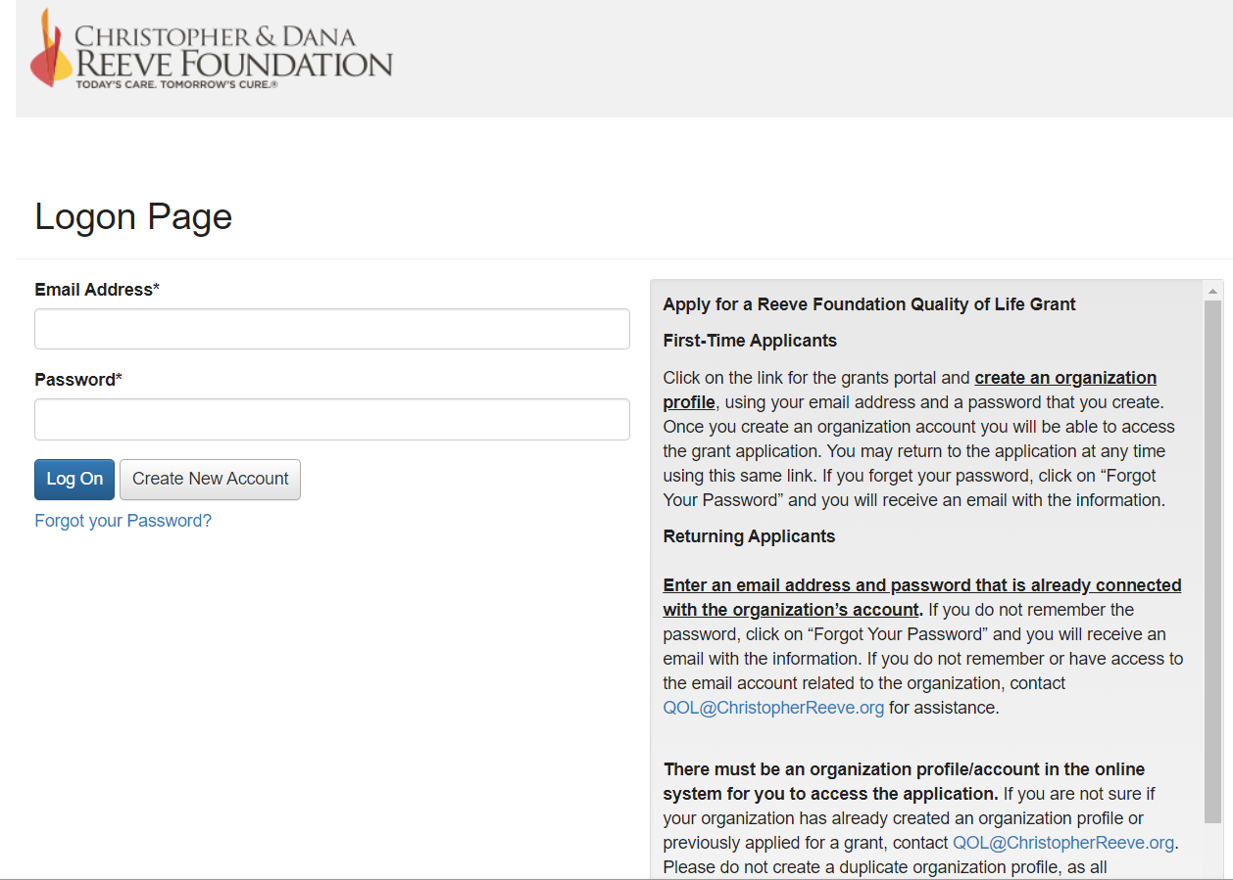
Notes:
On the right of the screen are detailed instructions on how to apply and set up your organization. Create an account if you are a first-time applicant, returning applicants use the email address you used before. If you need assistance login, please send an email to QOL@christopherreeve.org and we will assist you in getting your login-credentials. Also, at this time, if any of the contact information or addresses have changed, is a good time to update it. And provide at least 2 contact names
After clicking on the link to access the Reeve Foundation grant portal, you will be brought to the Logon Page. If this is your first time applying for a grant, you will need to create a new account. Click on the “Create New Account” button and you will be asked to input contact information, please provide a minimum of 2 contacts, and information about your organization (thus, creating an organizational profile). If you need assistance, there is a link to a registration tutorial video on the portal page or email us here at QOL@ChristopherReeve.org.
If you have applied in the past enter your email address and the password that you had previously created. If you’ve forgotten your password, click on the “Forgot your Password?” link and an email will be sent to you with your password. If you do not remember or have access to the email account related to the organization, contact QOL@ChristopherReeve.org for assistance. It’s really important that you enter an email address and password that is already connected with the organization’s account. Please do not create a duplicate organization profile, as all organizational application history is connected to the grant profile.
Please be sure to review your organization and contact profiles in the online system and update them with your most current information.

Slide 25
Notes:
As we go over the application, we have provided screen shots to share with you as we go along, I am sorry if the print is small, but you should be able to see them clearly when you are completing the application. First of all the links are available for the Guidelines for Discussing People with Disabilities and our Application and Program Guidelines -Make sure you review the language guide and confirm that you understand them.

Slide 26
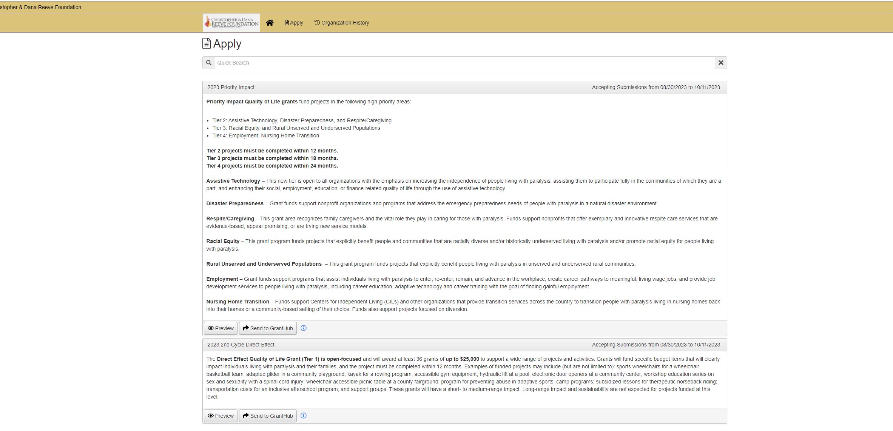
Notes:
This is the apply page, to start your application, where you select priority or direct effect. You also have the option to select preview here – it will take you the next screen, where you can select question list, and download a pdf of all the questions in the application
Granthub is an app where you can keep track of your grants, deadlines etc, if you are applying to other organizations.

Slide 27
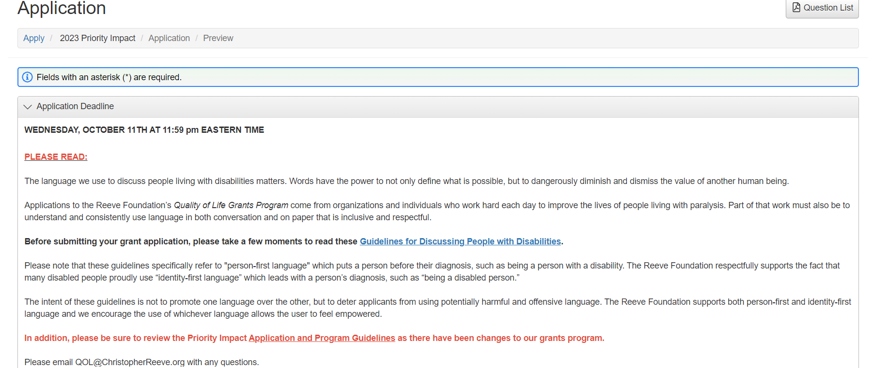
Preview Questions
Notes:
By selecting question list on the top right it will provide you with a document with all the questions in the application, if you would like to work off line before submitting

Slide 28
Eligibility – WHO IS ELIGIBLE TO APPLY
Nonprofit organizations with IRS 501(c)(3) tax status, municipal and state governments, school districts, colleges & and universities, recognized tribal entities, and other institutions such as community health centers or veterans hospitals.
Notes:
You will see these questions also in the application to determine if you are able to proceed. This is s a quick summary of the eligibility questions to determine
Who can apply

Slide 29
Eligibility – WHO IS NOT ELIGIBLE TO APPLY
The applicant organization is INELIGIBLE if it:
is a For-Profit organization
is a Nonprofit organization acting as a Fiscal Sponsor for a for-profit company
is a Fiscal Sponsor applying on behalf of non-501(c)(3) nonprofit organizations
does not have its own 501(c)(3) tax determination status or is not part of or chapter of a national organization that is a 501(c)(3) nonprofit organization
is a 501(c)(4) organization that does not have 501(c)(3) status
has a CURRENT or OPEN grant with the Reeve Foundation irrespective of grant program/tier that has not met the mandatory 12-month waiting requirement to re-apply. Previously awarded grantees may apply for this cycle ONLY after one year of the close of the prior grant and notification of grant closure by the Reeve Foundation
Conducts business or uses vendors outside the United States
Notes:
And who cannot apply

Slide 30
Eligibility Questions
Please answer the following ELIGIBILITY QUESTIONS. A “Yes” response will indicate that your organization and/or project are not eligible for funding.
Is your organization or project based outside of the U.S.?*
Does your project utilize contractors or vendors outside of the U.S.?*
Will grant funds support Research?*
Will grant funds support Rehabilitative Therapy?*
Will grant funds provide equipment or supplies to individuals permanently or as a gift?*
Does the equipment NOT adhere to the functions of providing access and promoting independence?*
Will grant funds support the development of prototypes involving intellectual property rights?* This includes the invention of equipment or other research and development activities.
Will grant funds support construction of buildings/major construction?*
Will your project serve less than three individuals with paralysis, their families, or caregivers?*
Will grant funds support fund raising events or paid fund raiser positions?*
Will grant funds support lobbying and/or efforts to influence legislation?
Will grant funds support a project(s) that has already been completed?*
Will grant funds support food (meals, per diem, board, lunch, beverages, water, alcohol, etc.)?*
Will grant funds support medical services?*
Notes:
This is a screen shot of what it looks like on the application, but is basically asking you about eligibility factors with just went over.

Slide 31
Funding Restrictions – Not able to fund
Funding Restrictions – NOT ABLE TO FUND
Money given to individuals, for example directly to a family to pay for respite care, travel reimbursement directly to a participant and not a company, costs of t-shirts, uniforms
Research
Rehabilitative Therapy
Notes:
o However, programs that assist people living with paralysis to participate in exercise opportunities are allowable. ▪ Programs that use physical or occupational therapists to work directly with persons with paralysis are considered part of rehabilitative therapy. ▪ Exercise opportunities that are facilitated by someone who, for example, has a bachelor’s degree in exercise science or is a certified fitness instructor would be an allowable expense.

Slide 32
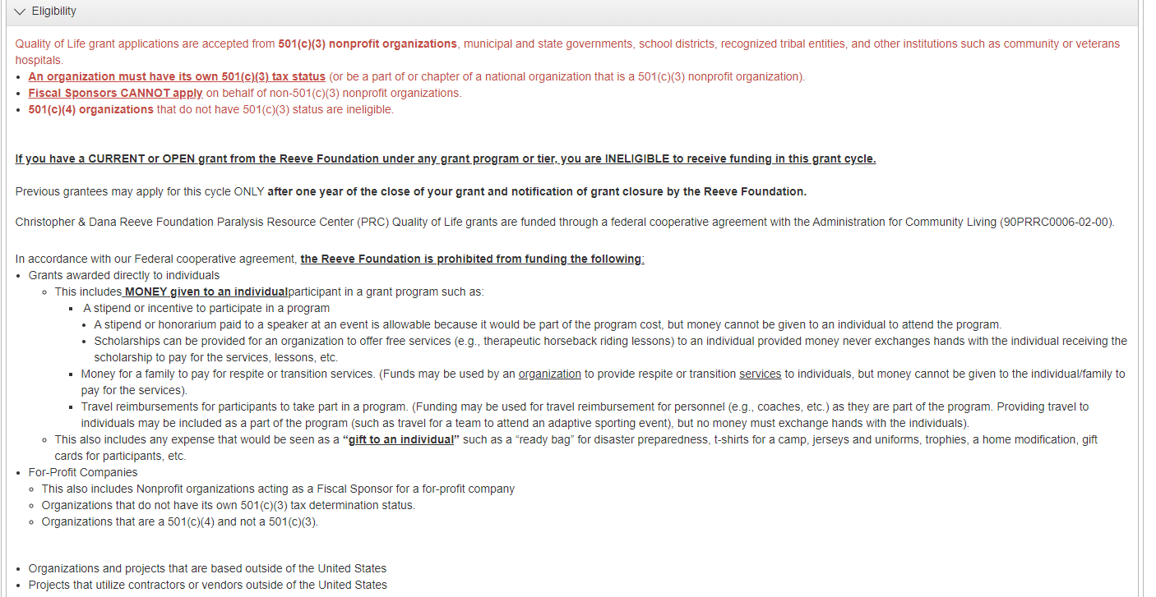
Eligibility
Notes:
And this what is looks like on the application

Slide 33
EQUIPMENT
Equipment can be funded if it Provides Access and/or Promotes Independence.
Providing Access: Adaptive strollers that are used as part of a program, are not given out to individuals and remain onsite; a transfer chair at a community pool; a stair lift, an examination table, or gynecological examination table in a rural area where no such equipment is available in that region, etc.
Promoting Independence: A scale (Knowing your weight promotes independence. It allows people to remain healthy, as being overweight can lead to a myriad of chronic health conditions.); Beach wheelchairs and adaptive bikes at a community park or sports wheelchairs for a community sports team (these examples could also fit under the area of providing access).
Equipment may be purchased under the Nursing Home Transition grant program. See allowable expenses pertaining to that program
Notes:
Equipment can be funded if it Provides Access and/or Promotes Independence. So, for a couple of examples:
For Providing Access: Adaptive strollers that are used as part of a program, are not given out to individuals. They would remain onsite; a transfer chair at a community pool; a stair lift, an examination table or gynecological examination table in a rural area where no such equipment is available in that region.
And for Promoting Independence: A scale (for knowing your weight) promotes independence. It allows people to remain healthy, as being overweight can lead to a myriad of chronic health conditions.); Beach wheelchairs and adaptive bikes at a community park or sports wheelchairs for a community sports team (these examples could also fit under the area of providing access as well as independence).
Gym equipment that is providing access is allowable, however NOT gym equipment that you have to have a physical therapist or medical-type personnel guiding you through the process or use in therapy.
Lets see how we apply this to our budget template.

Slide 34
Notes:
Equipment
However, it is allowable to fund Loan Closets. Otherwise equipment provided to individuals to keep is considered a gift. Is important that you detail in your application how the loan closet will be managed. Requests for loan closets must include a specified period of time. A device loan is typically 4 to 6 weeks (and sometimes up to 9 weeks/3 months) and enables individuals to try out and familiarize themselves with Assistive Technology or Durable Medical Equipment before acquiring it on their own-embedded and long-term loan closets will not be considered. (This also applies to ramps.)
Internet Service can be provided through the LOAN of hotspot devices or a tablet with internet service included.

Slide 35
Funding Restrictions
The development of prototypes for the invention of equipment or other research and developmental activities involving intellectual property rights.
Construction of Buildings/Major Construction
Notes:
We cannot fund the development of prototypes for invention of equipment or other research, or developmental activities involving intellectual property rights.
We also cannot fund Construction of Buildings/Major Construction
However, funds may support simple accessibility modifications to existing structures, playgrounds, trails, and other things like that.
Requested funds for simple accessible bathroom modifications, for example, are allowable if they are for an already existing bathroom. Allowable expenses would include grab bars, accessible toilets and sinks, etc. We cannot fund the building of a new bathroom or a major renovation of the existing bathroom.
If, for example, you are requesting funds for an accessible lift or elevator, this would be allowable under equipment that provides access and promotes independence. We cannot fund the excavation or construction of the elevator or shaft, as that would be considered major construction.
Lifts & elevators are generally simple plug-in devices that help people get up a few stairs or from one floor to another. It’s not major modifications – construction of an elevator shaft..

Slide 36
Funding Restrictions
New Playground Construction
The construction of new playgrounds is not eligible for funding. We cannot fund the installation of a new playground on land where a playground did not already exist.
However, funds may support the modification of older, non-accessible playgrounds or parks.
Requesting funds for the replacement of older, non-accessible playground equipment or ground covering are eligible for an existing playground.
Minor relocations of playgrounds are allowable.
Notes:
When it comes to playgrounds,
Modifications or minor relocations of older, non-accessible playgrounds or parks are allowable. We cannot fund any playgrounds that will be entirely new where a playground did not exist before.
For example, we see many applications for fully accessible playgrounds in school districts or towns that currently have no inclusive and accessible options for children living with paralysis and their families. If a school comes to us with a proposal that says they’re completely renovating their non-accessible playground to make it fully accessible and inclusive, because they’re replacing the older playground, we can fund things such as pour-in-place surfacing or accessible and inclusive playground structures. If this school did not have a playground before and is installing a brand-new playground for the first time on the property, we are not able to fund that. If minor relocations are happening within the same property, such as moving the playground to a more accessible location on school grounds, that would be considered eligible as well. But relocations must remain at the same property, once it becomes a change of address it is no longer a minor relocation.

Slide 37
Notes:
When it comes to playgrounds,
Modifications or minor relocations of older, non-accessible playgrounds or parks are allowable. We cannot fund any playgrounds that will be entirely new.
For example, we see many applications for fully accessible playgrounds in school districts or towns that currently have no inclusive and accessible options for children living with paralysis and their families. If a school comes to us with a proposal that says they’re completely renovating their non-accessible playground to make it fully accessible and inclusive, because they’re replacing the older playground, we can fund things such as pour-in-place surfacing or accessible and inclusive playground structures. If this school did not have a playground before and is installing a brand-new playground for the first time on the property, we are not able to fund that. If minor relocations are happening within the same property, such as moving the playground to a more accessible location on school grounds, that would be considered eligible as well. But relocations must remain at the same property, once it becomes a change of address it is no longer a minor relocation.

Slide 38
Notes:
This is a page confirming that you have reviewed the eligibility questions

Slide 39
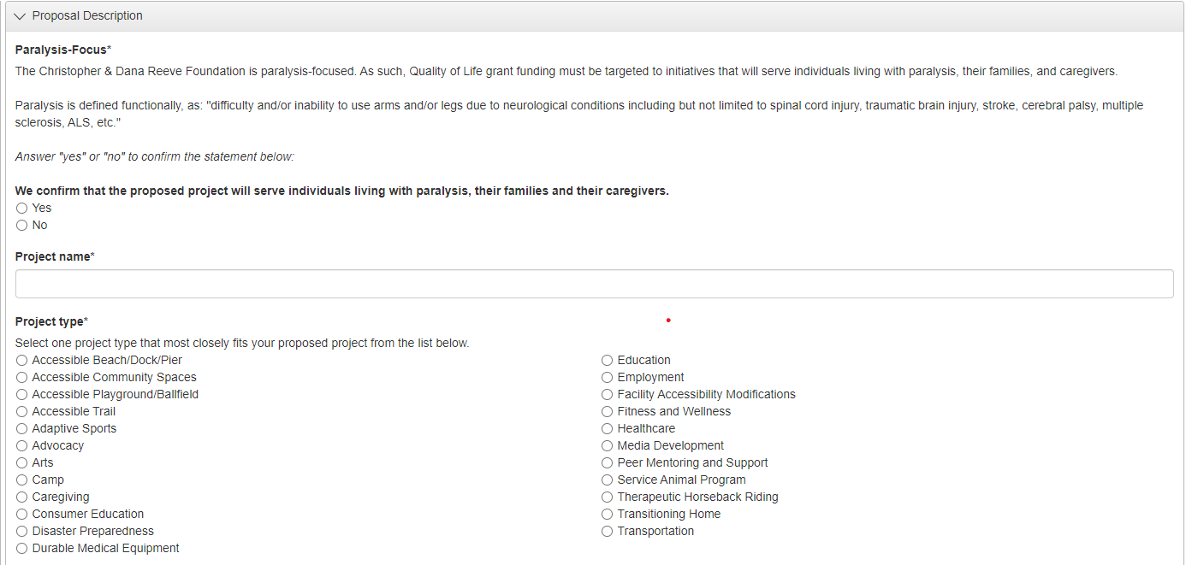
Notes:
Requires confirmation that the project will serve individuals living with paralysis,
Project name
Project type
These are for direct effect, we will talk about expanded impact later

Slide 40
Provide a simple and short summary of the project, which outlines the why (need), what (activities, offerings), and how (Reeve funding support) of your project. I suggest keeping it simple as other specific project components, like timeline, goals, impact, etc. are covered under different sections of the application. For example, We currently have 20 people with paralysis as registered users of our fitness equipment at no cost. One of our most popular equipment X is old and failing. We are the only organization in a 20-mile radius to offer this opportunity. The installation and use of new equipment X will allow us to safely provide services to individuals with paralysis. The fitness opportunity benefits both mentally and physically. This equipment has had a proven positive impact on the health, fitness, and QoL of our participants with paralysis. Equipment X would be installed at the X facility, located at X address. The anticipated date of installation is X. The requested Reeve funding will support the purchase of equipment X.
Notes:
? What do we want to see here ???/ examples of a good description
. Provide simple and short summary of project which outlines the why (need), what (activities, offerings), and how (Reeve funding support) of your project. I suggest keeping it simple as other specific project components like timeline, goals, impact, etc. are covered under different sections of the application.
For example: We currently have 20 people with paralysis as registered users of our fitness equipment at no cost. One of our most popular equipment X is old and failing. We are the only organization in a 20-mile radius to offer this opportunity. The installation and use of new equipment X will allow us to safely provide services to individuals with paralysis. The fitness opportunity benefits both mentally and physically. This equipment has had a proven positive impact on the health, fitness and QoL of our participants with paralysis.
The Equipment X would be installed at the X facility, located at X address. The anticipated date of installation is X. The requested Reeve funding will support the purchase of equipment X.

Slide 41
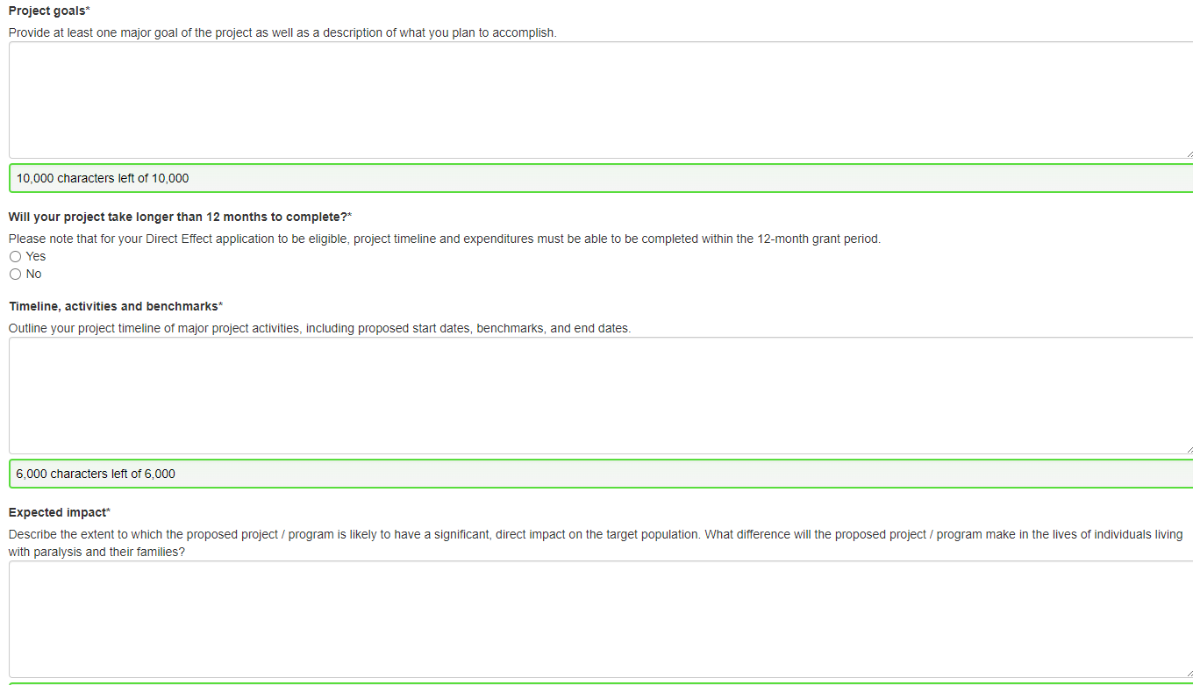
What is it that you want to achieve as a result of this project and what will you be doing to achieve them?
For example: Increase access to fitness opportunities for people with paralysis by offering X # of free fitness training classes or memberships to our facilities to people with paralysis. These classes will be led by certified professionals who will assist participants in achieving their individual goals.
What impact will the project have on the target population? Their family members/caregivers?
For example, the free beach access program will have a long-lasting impact on people with paralysis and their caregivers. The program will provide a feeling of inclusion and connection with others in a fun and safe environment. The project would create an opportunity for all to make long-lasting memories.
Notes:
: What is it that you want to achieve as a result of this project and what will you be doing to achieve them?
For example: Increase access to fitness opportunities for people with paralysis by offering X # of free fitness training classes or memberships to our facilities to people with paralysis. These classes will be led by certified professionals who will assist participants in achieving their individual goals.
When it comes to the timeline, please make sure that all approvals and purchases are attainable during that 12 month period or longer for the priority impact.

Slide 42
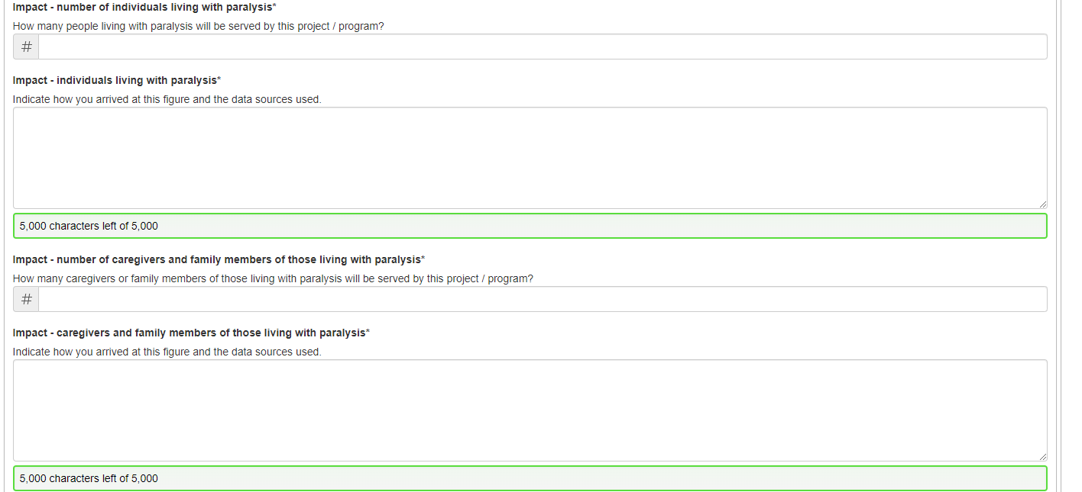
Notes:
This applies to the number of people that will be served during the project time line in this case, 12 months

Slide 43
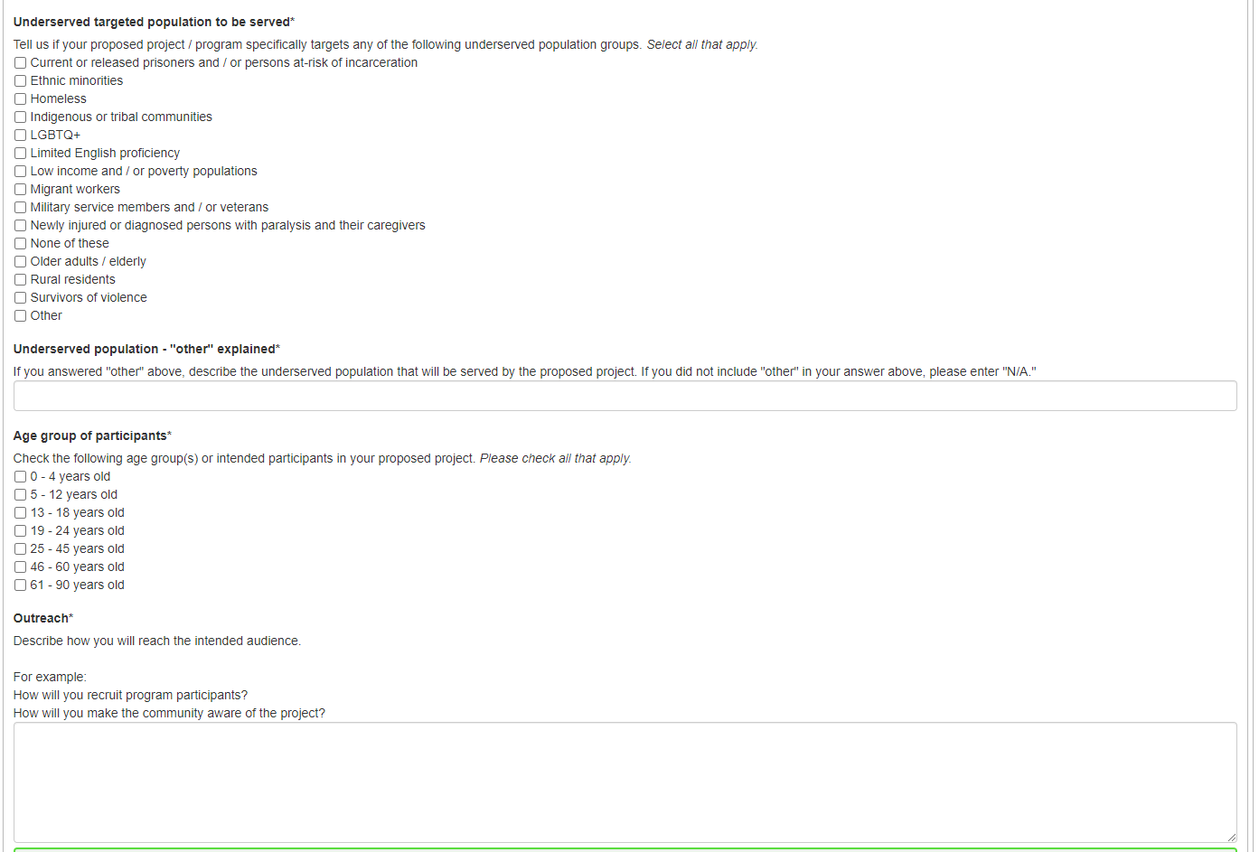
Notes:
Complete the demographics – if you are applying for Priority Impact rural communities, it will ask you about the rural communities you are planning to serve, and we went over that on the priority impact tier slide

Slide 44
WHERE TO FIND AREA DATA
Disability Counts Data Finder. This online tool lets you view and download disability data for every country in the United States. The data includes disability rates, types of disability, whether the county is classified as rural or urban, and population.
Map Series: Disability in America. This is a set of maps that show information about disabilities. The maps show the rates of disability for every county in the United States. There are maps for many topics, including veterans, poverty, and employment. There are also maps for different kinds of disabilities including hearing, seeing, waking, cognitive, self-care, and independent living.
Rural Health Grants Eligibility Analyzer from the Health Resources and Services Administration (HRSA).
Notes:
If you need to assistance in determining the number of people living with a disability in your area, here is some information on websites that can assist with that

Slide 45
You will need to identify the approach to take to achieve expected goals/outcomes. Based on what you expect to achieve through this project, How will you measure the benefits of the project? For example, if your goal is to serve 20 people with paralysis and at least 90% of participants will report improved quality of life then your evaluation methods could be: We will use registration forms to track people and solicit end user/participant feedback at the end of the class. The survey will be designed to include various targeted questions regarding the benefits of the class and new equipment.
And this is what you would report on your final report:
The fitness class was offered to 20 people with paralysis. Of these 20 participants, 16 individuals completed our participant survey. 15 or 95% of surveyed individuals reported a marked improvement in their quality of life.
Notes:
You propose it and we will measure it-
Provide specific measures to be used , surveys for example- Link to establishing evaluation indicators for more information

Slide 46
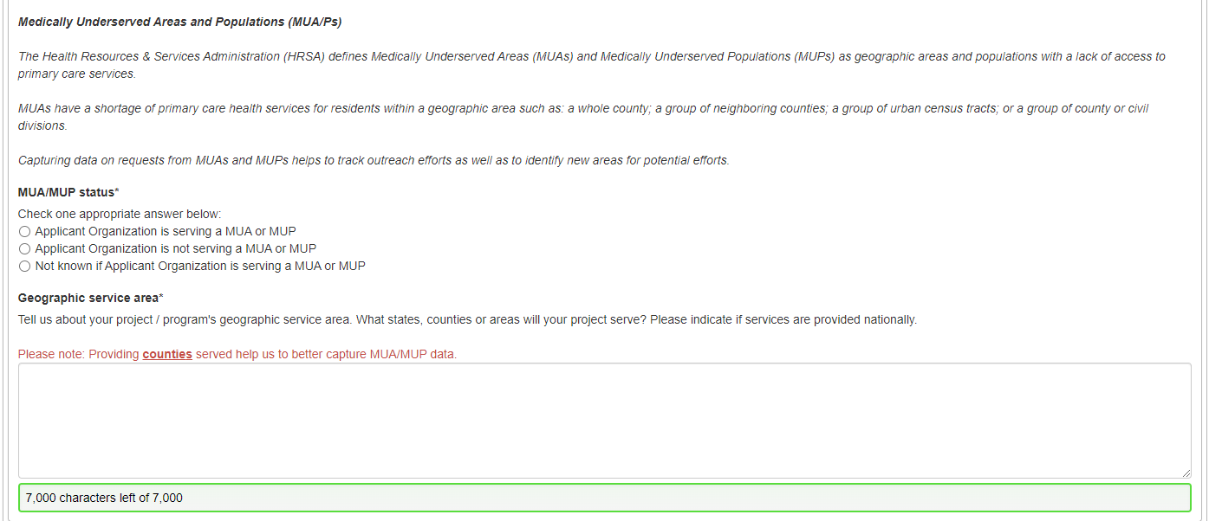
Notes:
We use this information when reporting to ACL , so please complete the MUA/MUP Status and Geographic service area

Slide 47
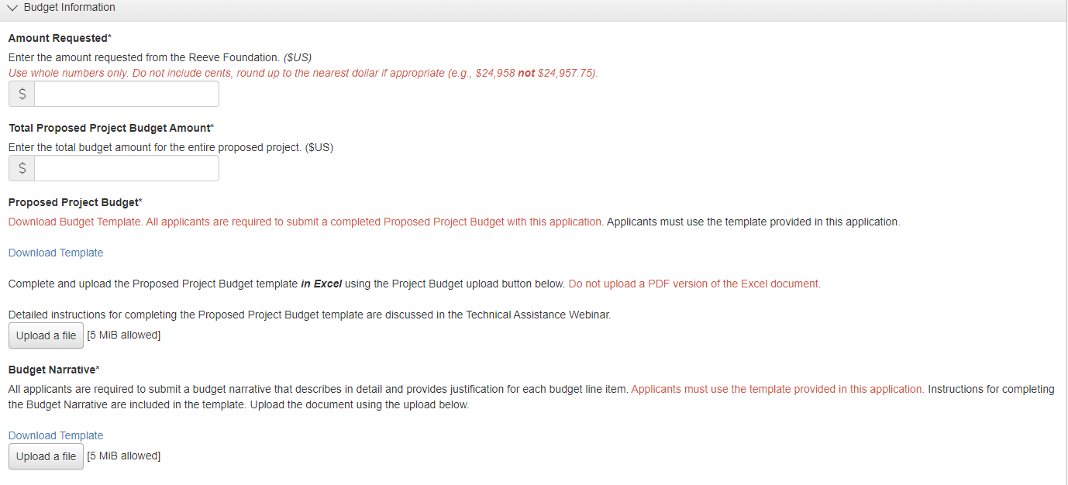
Notes:
Next we move to the budget Amount Requested, for Direct Effect is up to 25,000
And priority impact depending on the tiers
Enter what the total project is going to coast
Then you need to detail this in the excel project template
We’ve also revised the Project Budget Template. The new template is downloadable straight from the application, so please use that document. Any applications using older versions of budget templates may be eliminated. We have a video tutorial on our website which walks you through filling out the budget template.

Slide 48
Allowable Expenses
ALLOWABLE EXPENSES
Wide range of programs and services
Programmatic personnel, consultants, and contracted workers
Entry fees
Transportation costs
Facility rental
Travel reimbursement
Travel (up to):
Airfare $500
Train $275
Hotel $225 per night
Mileage 62 cents per mile
Equipment (see funding restrictions)
Supplies, etc.
Notes:
Ok, so now is the fun part – all the things that we can fund. If this is your first time applying for a Quality of Life grant, you’ll be surprised at just how many different project categories we are able to fund each year. Funds can support a wide range of programmatic expenses for different programs and services – which we covered in the Direct Effect descriptions slide.
Grant funds can support programmatic personnel, consultants and contracted workers, entry fees, transportation costs, facility rental, travel reimbursement, marketing, equipment (though please see the equipment funding restrictions I talked about a few minutes ago), supplies, and more.
For Travel – these are same guidelines we adhere to in our federal cooperative agreement and the limits are listed here
Airfare $500
Train $275
Hotel $225 per night
And Mileage is reimbursed at 62 cents per mile and please use them when completing your budget template

Slide 49
Allowable Expenses
ALLOWABLE EXPENSES
Administrative or Indirect Costs – A de minimis indirect cost rate of no more than 10% is allowable. However, if your organization has a Negotiated Federal Indirect Cost Rate Agreement ( or NICRA) you may include indirect costs at the federally negotiated rate. Please note that a copy of your current NICRA will be required if your application is approved for funding.

Slide 50
Programmatic expenses directly related to serving individuals with paralysis and their families are considered more favorable than operational expenses and/or large capital projects.
Notes:
Programmatic expenses directly related to serving individuals with paralysis and their families are considered more favorable than operational expenses and/or large capital projects.

Slide 51
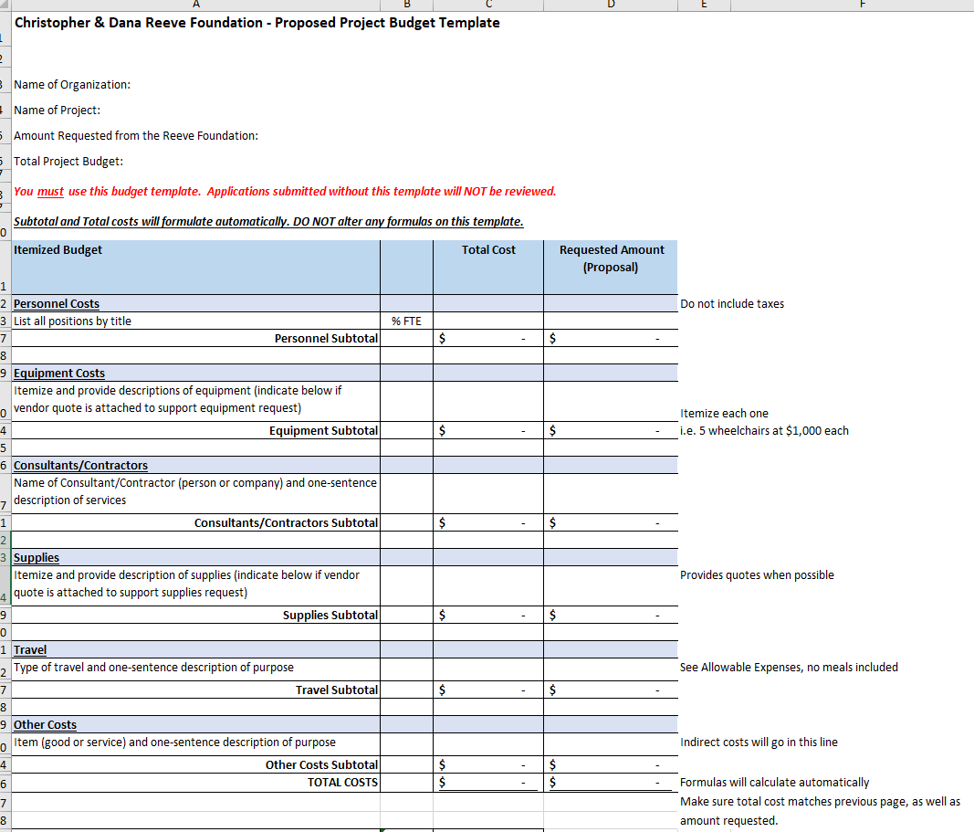
Proposed Project Budget Template

Slide 52
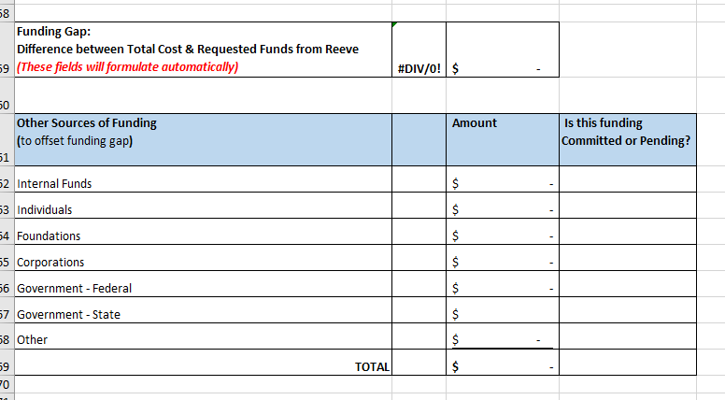
Notes:
If we are partially funding the project, we want to know the current position of the balance of the funds.
Is helpful for us to see how much our funds are contributing to the total project

Slide 53
Christopher & Dana Reeve Foundation Quality of Life Grants Program
Budget Narrative Requirements
Name of Organization:
Name of Project:
Amount Requested:
Total Project Budget:
The budget narrative must include a description and justification of each budget category and line item presented in your proposed budget. All expenses listed on the budget template should clearly match the items listed in this narrative.
Notes:
The budget narrative is the excel sheet in writing. Go line by line in your budget template and include a description and justification of each budget category and line-item presented in your proposed budget. Please do not list ANYTHING on this narrative that you’re not requesting funding for
The budget narrative should really help us get a better understanding of what the grant funds are being used for.
There is also a copy of this narrative template downloadable straight from the application. Please use the provided template instead of creating your own narrative.

Slide 54
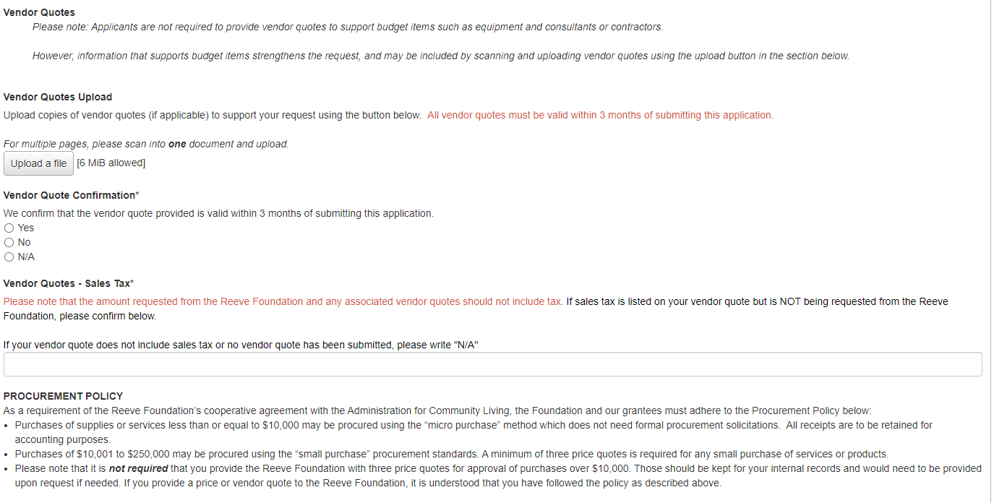
Notes:
Vendor Quotes
Vendor quotes are strongly recommended (especially for all equipment purchases and consultants/contractors) and can strengthen your request.
Vendor quotes and other information that support budget items may be scanned and uploaded using the upload button

Slide 55
Notes:
What is your budget strategy if this project is not funded by Reeve
Supporting materials are always welcomed, but are optional

Slide 56
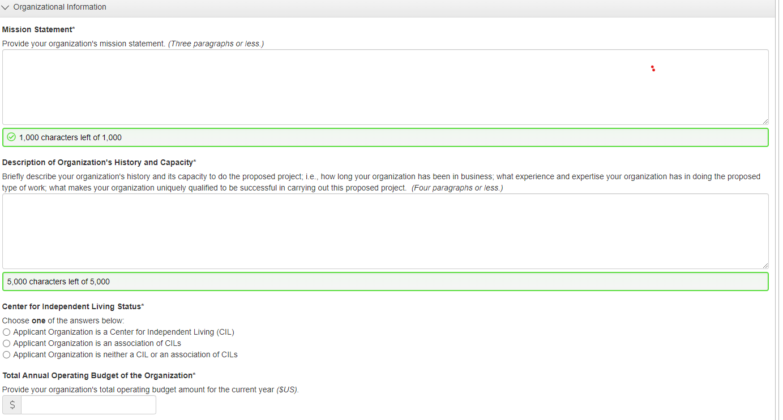
This part should list who you are, what you do, and how you do it. The reason your organization is in place.
Notes:
Your organizations aims and values, a brief history, are you CIL , operating budget

Slide 57
UNIQUE ENTITY ID
Organizations requesting $25,000 or more MUST provide a valid SAM.gov issued Unique Entity ID. If you already have a SAM.gov-issued Unique Entity ID, you will need to include it below under the Organizational Information section. If you do not have one, we urge you to apply immediately as the SAM.gov processing time is very lengthy – see instructions below under the Organizational Information section.
Notes:
I want to remind you again, that All Federal Funded Grants to have this Unique Entity ID – they did away with the DUNS number and replaced with this UEI Number- If you are requesting 25K or more you must have this number and the zip + 4 number code

Slide 58
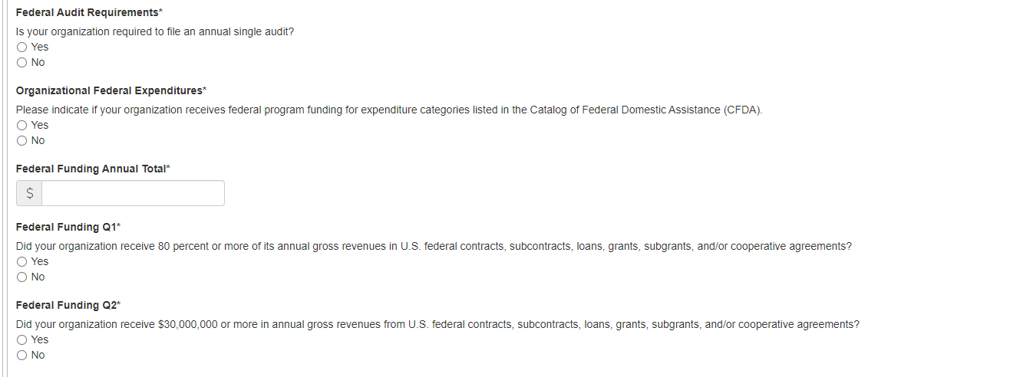
Notes:
General Federal Funding Questions

Slide 59
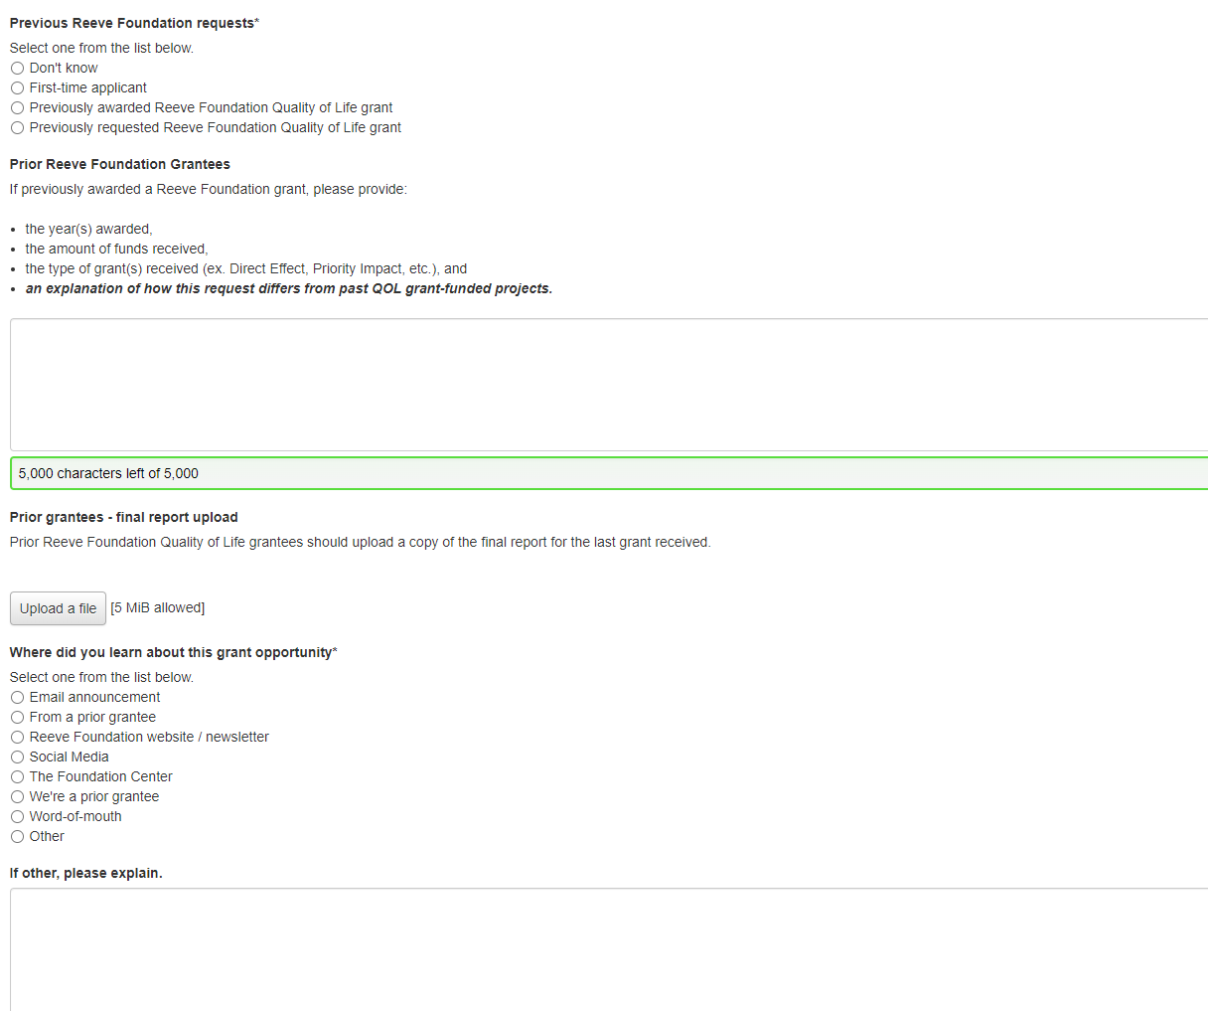
Notes:
Finally we want to know if you are a prior grantee, include a copy of your final report and we want to know how you learned about this grant opportunity.

Slide 60
Notes:
You can save the application at any time and go back to it by clicking the Save Application button.
Once you’ve completed the application - responded to the questions and uploaded the required documents - simply hit the submit application button.
A submission confirmation page will appear. The system will also send you an email indicating that your application has been received, so again please be sure that your email address has been entered correctly and that administrator@grantinterface.com is added to your contacts, because the email will be coming from that account.

Slide 61
Award Notification
Notification and Awarding of Funds
All applicants will be notified by email.
Grant checks are issued upon receipt of the signed grant award agreement.
Publicizing the Grant
We will provide tools to help you spread the word about your Reeve Foundation Quality of Life granted project, including a guide to publicizing the award and a press release template.
Upon notice of the award, grantees must indicate intent to accept the grant and sign and return a grant award agreement.
We regularly feature Quality of Life grantees in social media, on the website, and in newsletters and other publications, so we can call on you to provide stories and photographs that we can share with our community!
In addition, we encourage you to utilize all the free resources provided by the Reeve Foundation National Paralysis Resource Center (NPRC), and to link the NPRC as a resource on your website.
Follow the @reevefoundation on
Social Media!
Notes:
All applicants will be notified by email if their application has been approved or declined. If your project is awarded, you will be asked to indicate your acceptance of the grant. You will receive an intent to accept, where you accept or decline the award, and provide us the contact information for where the grant agreement and check should be sent.
Once the intent to accept form has been received, a grant agreement will be issued. The grant award agreement must be countersigned. Grant checks will be issued upon receipt of the countersigned award agreement.
We will also provide you with a press release template to help publicize the grant award, and we regularly feature our grantees on social media, on the website, and in newsletters and other publications, so we may call on you to provide stories and photographs that we can share with our community.

Slide 62
Grantee Requirements - Report Schedule
Grantees must submit progress reports to the Reeve Foundation
Direct Effect
(12-month grants)
Interim at 6 months
Final at 13 months
Priority
(depending on the Tier)
Update/Check-in at 6 months
Interim at 12 months
Update/Check-in at 18 months
Final at 25 months
An interim report will let us know whether the project is proceeding as planned or not, and if not, what we may be able to do to help get it back on track.
A final report will be due one month after the close of the grant period and will detail the project’s progress, challenges, how those challenges were addressed, the project’s impact, and final grant expenditures.
Notes:
We do require reports -
Grant recipients must submit progress reports to the Reeve Foundation. An interim report will let us know whether the project is proceeding as planned or not, and if not, what we may be able to do to help you get it back on track. A final report will be due one month after the close of the grant period and will detail the project’s progress, challenges, how those challenges were addressed, the project’s impact, and final grant expenditures. This schedule is outlined on the grant letter if awarded, and you will receive an email reminder . These reports will be available on your grant portal – Reports are assigned to the applicant, so please make sure that to let us know if that is the person the reports should be assigned to

Slide 63
Feedback
In adherence with the requirements of the Office of Management and Budget, we are unable to comment on denied applications or provide programmatic direction to organizations applying for Quality of Life grants, as giving feedback/direction would be providing an unfair advantage over other applicants.
Notes:
But please email us about general questions.

Slide 64
Thank You
Maria Fonseca
Grants Associate, Quality of Life Grants Program
ChristopherReeve.org
QOL@ChristopherReeve.org
@reevefoundation
Notes:
Thank you for your interest in our Grants Program. We look forward to receiving your submissions.
After the webinar if you have a question, please submitted to QOL@ChristopherReeve.org. The deadline for emailed questions is Tuesday, September 12th

